Slide 1

Types of Operating System
Lecture #3 and 4

Slide 2
Types of Operating System
Single User System
Batch System
Multiprogrammed System
Time Sharing system
Real-Time system

Slide 3
Single User Systems
An operating system that is usable by only one user at a time.
For example: Early personal computers
Interactive (i.e. whenever you want to run a software on a computer system you can interact with it)
Basic goal of single user system is to be convenient and responsive. (i.e. easy to use, friendly graphics etc.)
Example . DOS-operating system

Slide 4
Types of Single User System
Single user operating systems can be split into two types:
1- single user, single task
2- single user, multiple tasks

Slide 5
Types of Single User System
Single user, single tasks -- This type of operating system only has to deal with one person at a time, running one user application at a time.
E.g. Mobile phone
Single user, multiple tasks -- The operating system is designed mainly with a single user in mind, but it can deal with many applications running at the same time.
E.g. searching the internet, downloading a video file and also listening to a piece of music.

Slide 6
Multi-programmed System
Multiprogramming is a technique to execute number of programs simultaneously by a single processor.
In Multiprogramming, number of processes reside in main memory at a time.
The OS picks and begins to executes one of the jobs in the main memory.
If any I/O wait happened in a process, then CPU switches from that job to another job.
Hence CPU in not idle at any time.

Slide 7
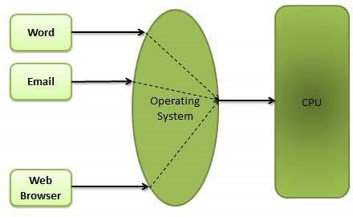
Multiprogramming

Slide 8
Batch Processing
In this type of system, there is no direct interaction between user and the computer.
The user has to submit a job (written on cards or tape) to a computer operator.
Each user prepares his job on an off-line device like punch cards and submits it to the computer operator.

Slide 9
Cont..
OS defines a job which has predefined sequence of commands, programs and data as a single unit.
OS keeps a number of jobs in memory and executes them without any manual information.
Jobs are processed in the order of submission i.e first come first served fashion.
When job completes its execution, its memory is released and the output for the job gets copied into an output spool for later printing or processing.

Slide 10
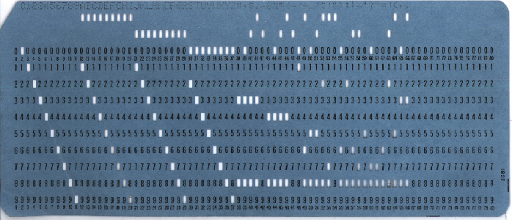
Punch Card

Slide 11
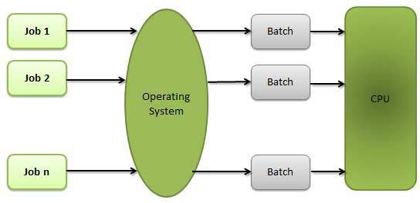
Batch Processing

Slide 12
Time Sharing Systems
Time sharing, or multitasking, is a logical extension of multiprogramming.
Multiple jobs are executed by switching the CPU between them.
In this, the CPU time is shared by different processes, so it is called as “Time sharing Systems”.
Time slice is defined by the OS, for sharing CPU time between processes.
Example ..UNIX, Linux,

Slide 13
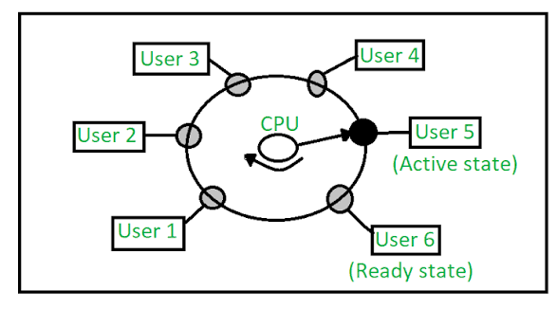
Time Sharing Systems

Slide 14
Real-Time Systems
A real-time operating system is an operating system (OS) intended to serve real-time application by processing data as it comes in, typically without buffering delays.
Often used as a control device in a dedicated application such as controlling scientific experiments, medical imaging systems, industrial control systems, and some display systems.
If it does not produce output in a defined time then the output will be useless.
For example
automobile airbag controllers, industrial robotics, air traffic control, and medical devices

Slide 15
Cont…
For example
automobile airbag controllers,
industrial robotics,
air traffic control,
medical devices

Slide 16
Questions?

